Slide 1

Assalamualikum
Welcome to our presentation

Slide 2

Project Name :Travel &Tour Management System
Team Name : Elite Things
Member Name:--
1)C193203 Nujhat Tabassum
2)C193213 Maisha Samia
3) C193219 Farhatul Zannat Khanam
4)C193257 Sharmin Akter
Course Code :CSE-3638
Course Title: Software Engineering Lab
Submitted to : Atia Binti Aziz
Adjunct Faculty
Dept. of CSE,IIUC

Slide 3
Introduction
The Tours and Travel Management System is a desktop based application. it’s a desktop base application. This application will help in accessing the information related to the travel to the particular destination with great ease. The users can track the information related to their tours with great ease through this application. The travel agency information can also be obtained through this application . The project ‘Tours and Travels Management System’ is developed to replace the currently existing system, which helps in keeping records of the customer details of destination as well as payment received.

Slide 4
Objectives
This application is a desktop based application and maintains a centralized repository of all related information. The objective of this project is to develop a system that automates the process and activities a travel agency and customers details. The purpose is to design a system using which one can perform all operations related to travelling and sight-seeing. This system also gives tours related information like which places are tourist attractions, cities, and provinces. The objective of the Travel and Tourism Management System project is to develop a system that automates the processes and activities of a travel and the purpose is to design a system using which one can perform all operations related to traveling.

Slide 5
TOOLS & software REQUIRMENTS
Technologies Used: Java
Database Used: MySQL , Xampp
IDE used: Netbeans

Slide 6
Packages
Hotel
Destination
Customer
features
Utility
About
Payment

Slide 7
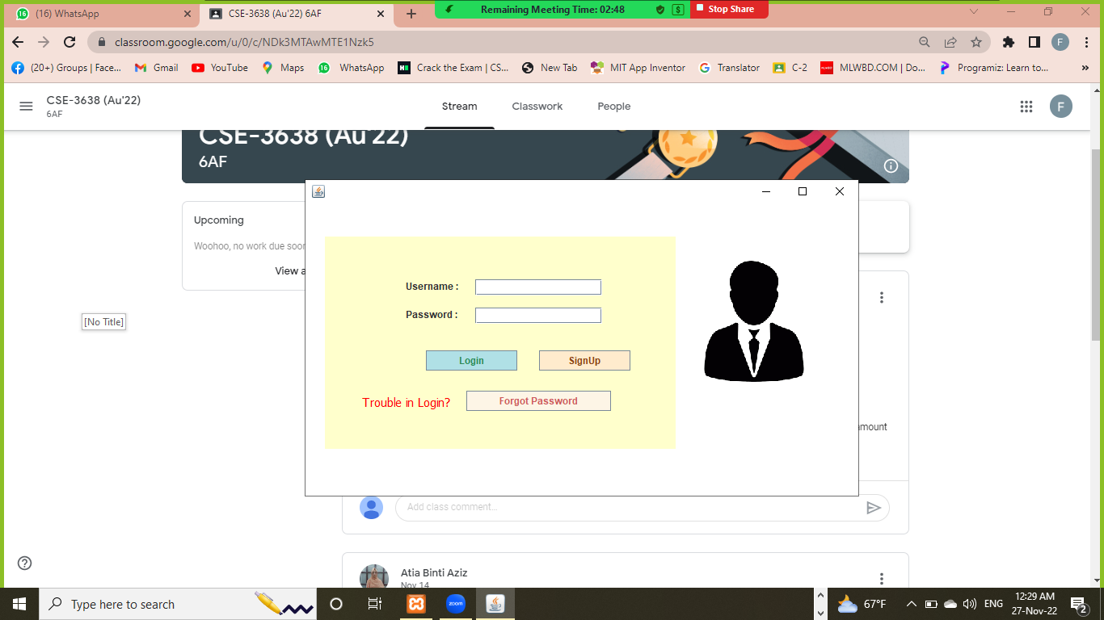
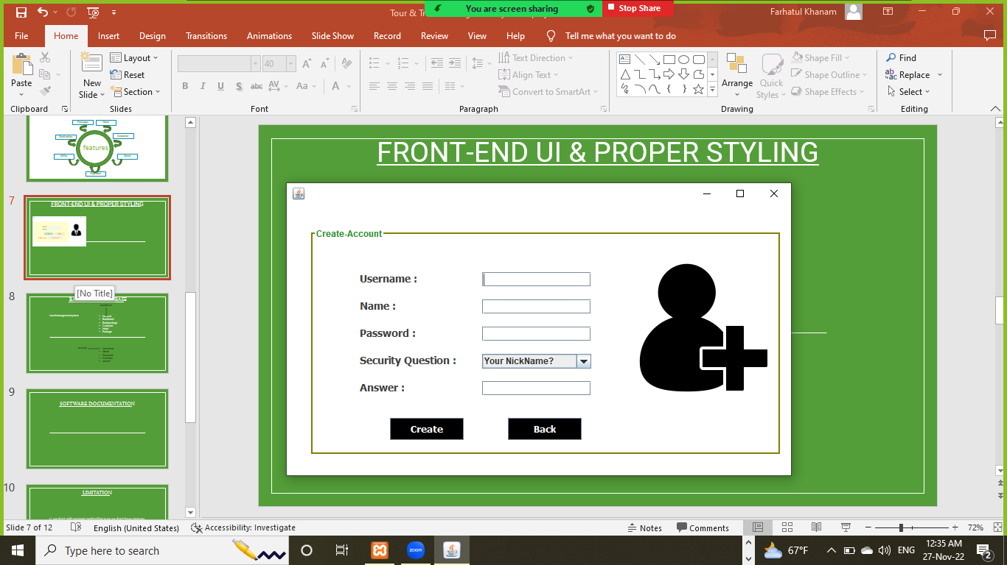
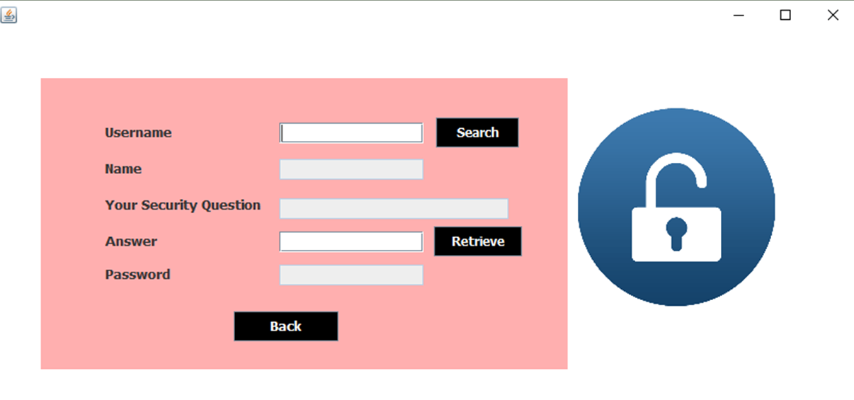
Front-End UI & Proper Styling
Login
Signup
Forget password

Slide 8
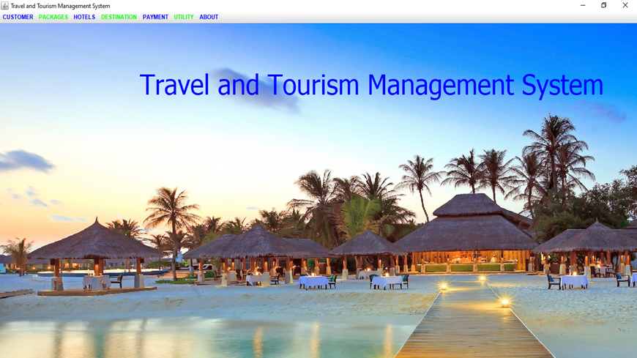
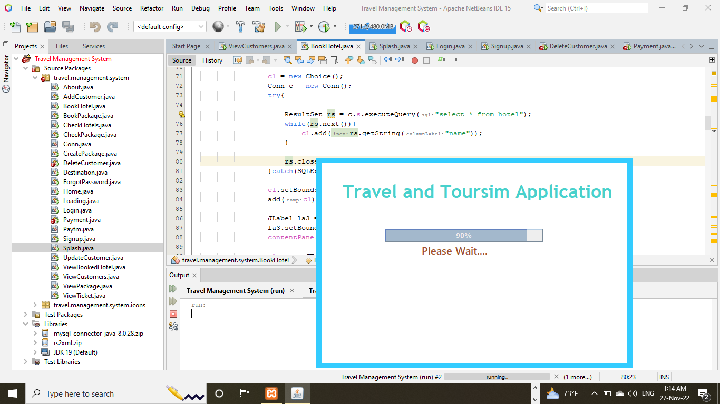
Front-End UI & Proper Styling
Homepage
Loading

Slide 9
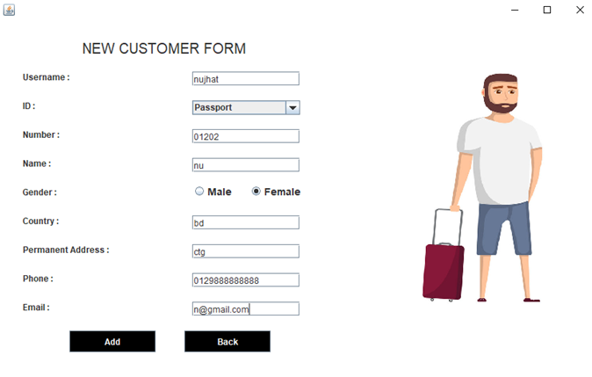
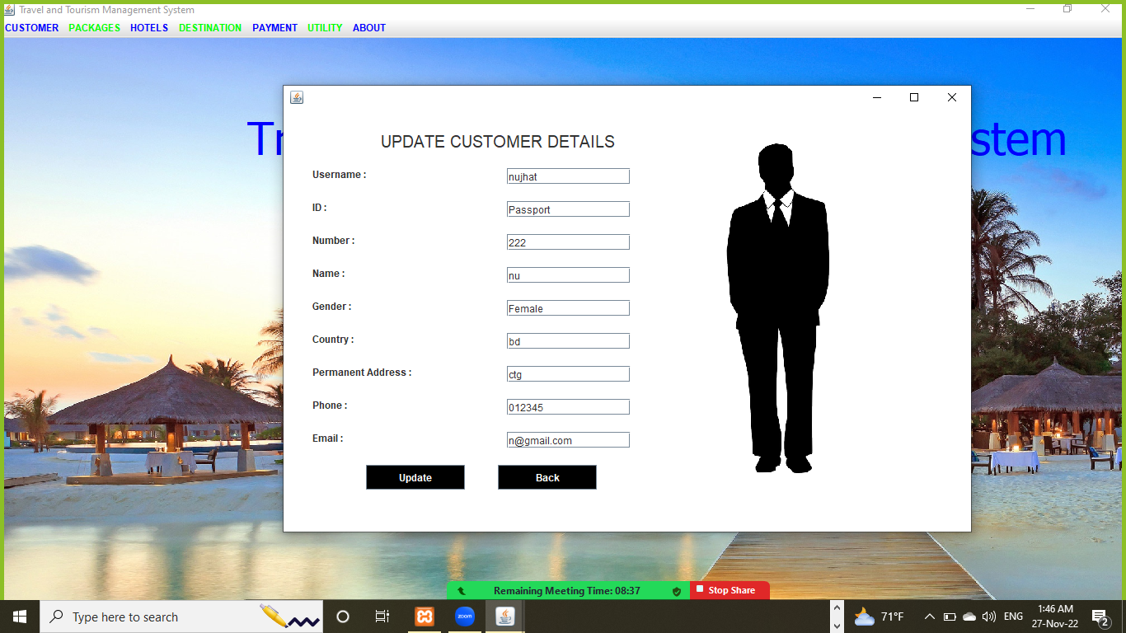
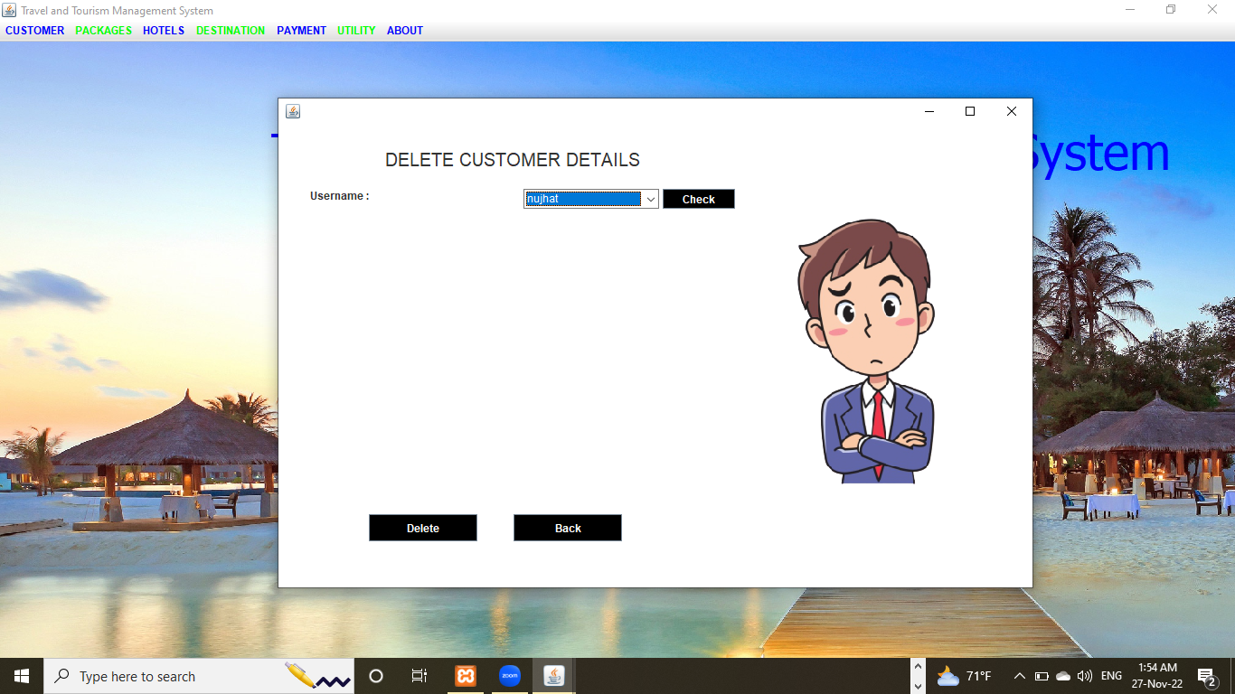
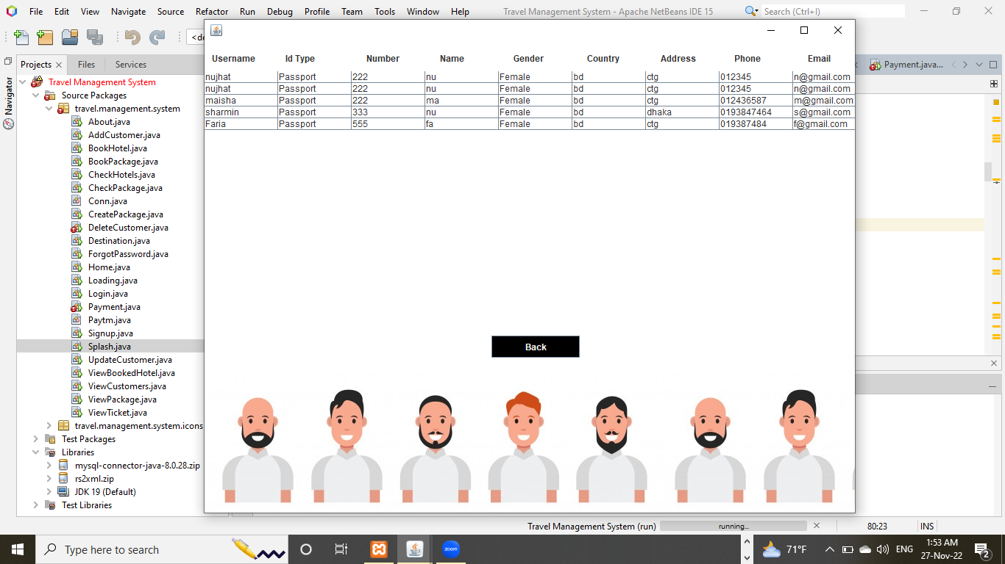
Front-End UI & Proper Styling
Customer Details

Slide 10
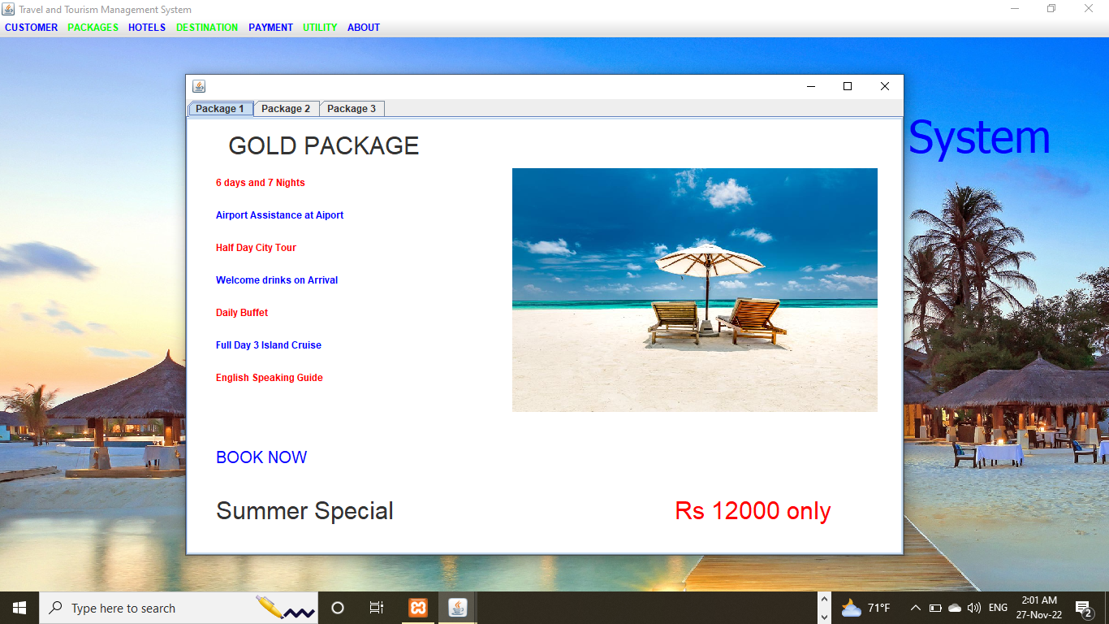
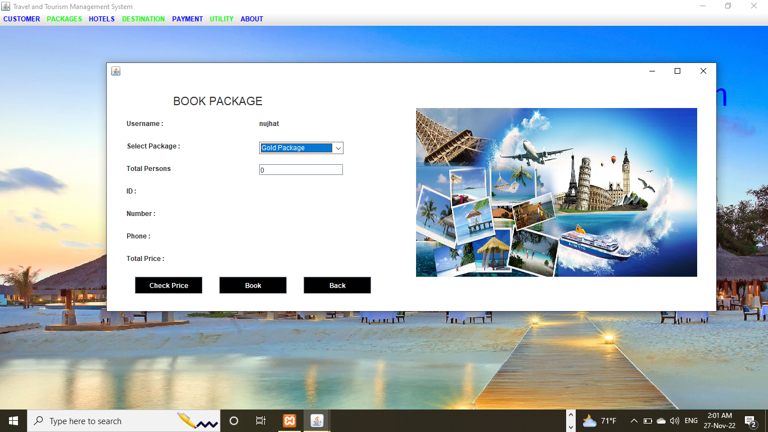
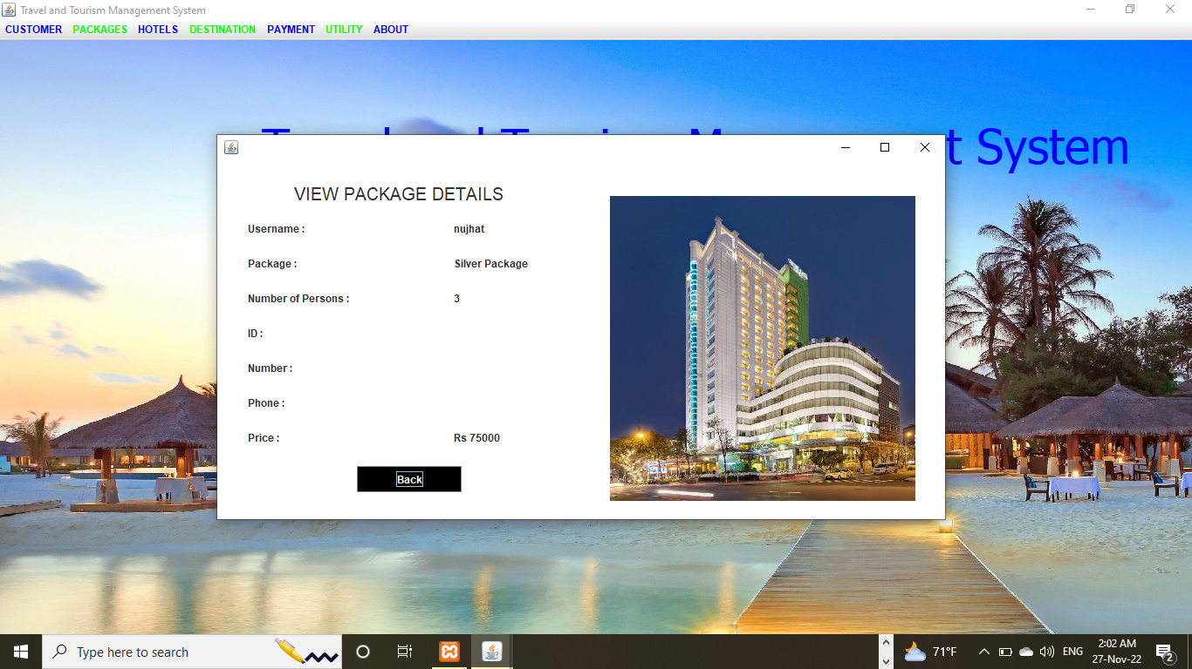
Front-End UI & Proper Styling
Package Details

Slide 11
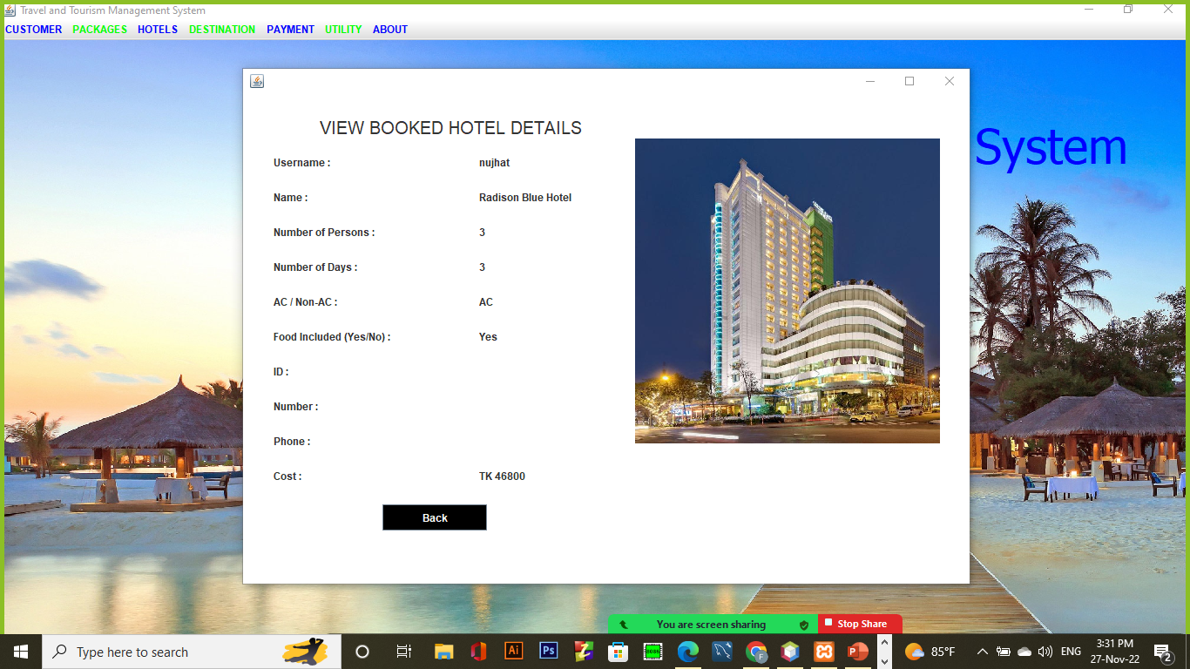
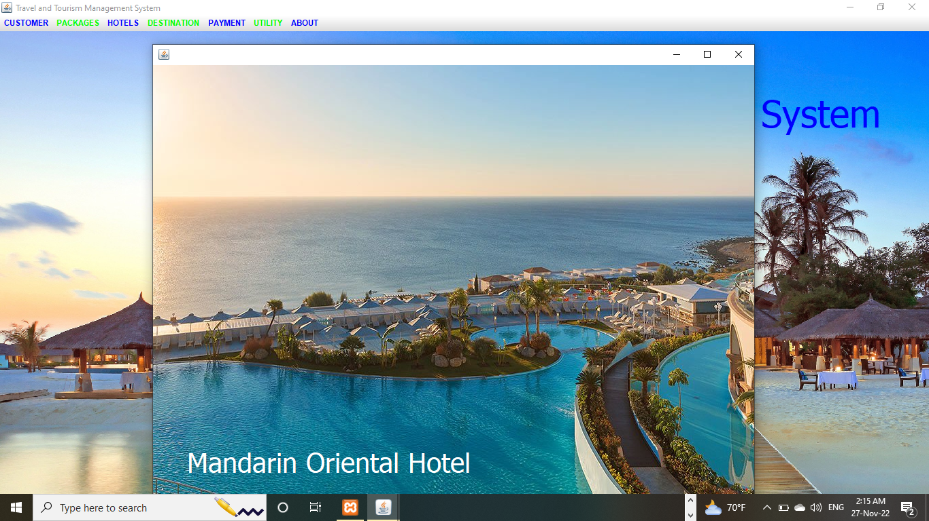
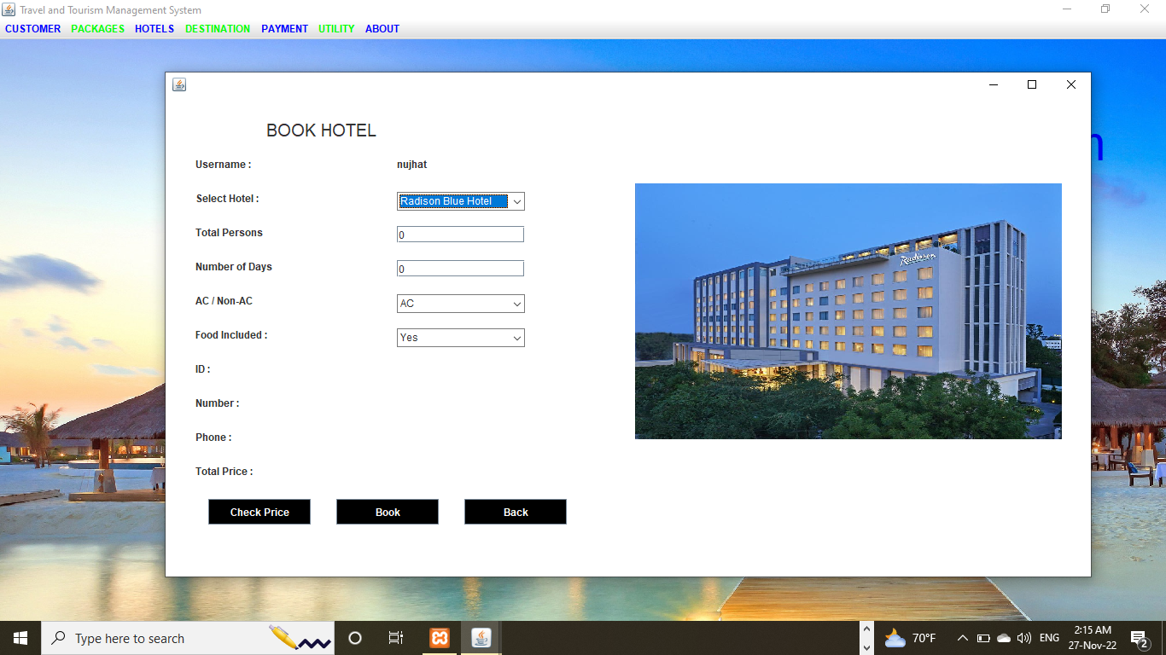
Front-End UI & Proper Styling
Hotels

Slide 12
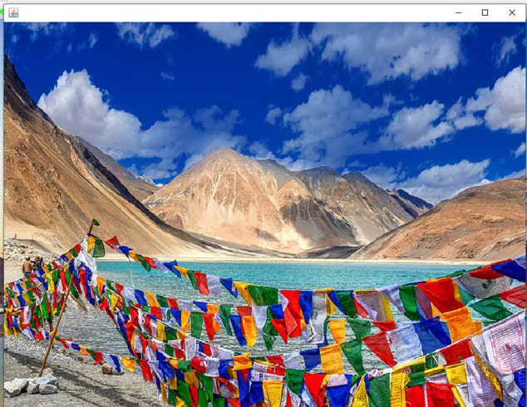
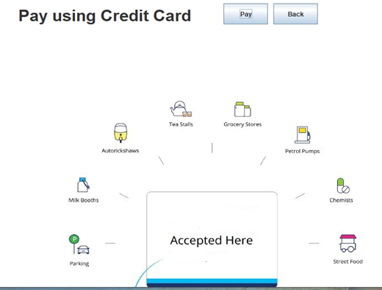
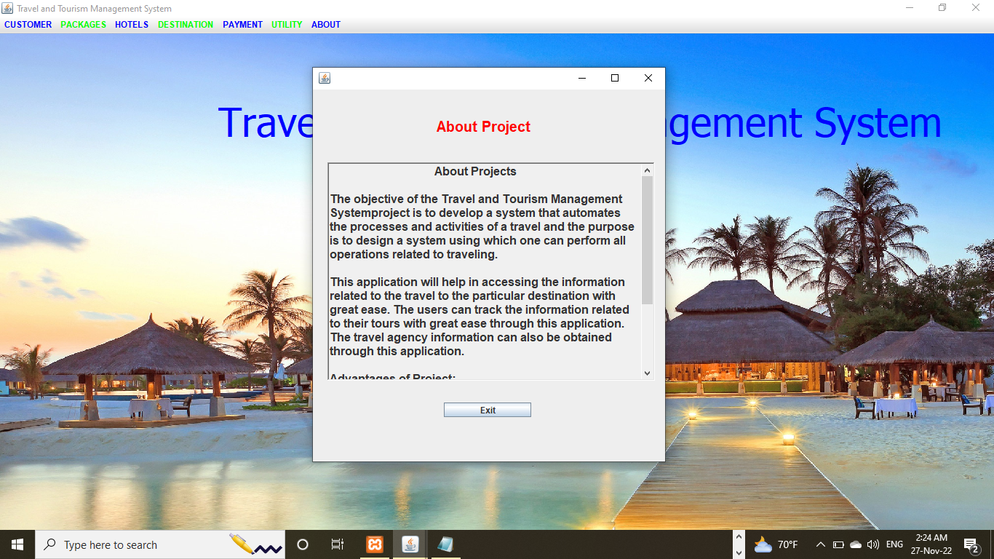
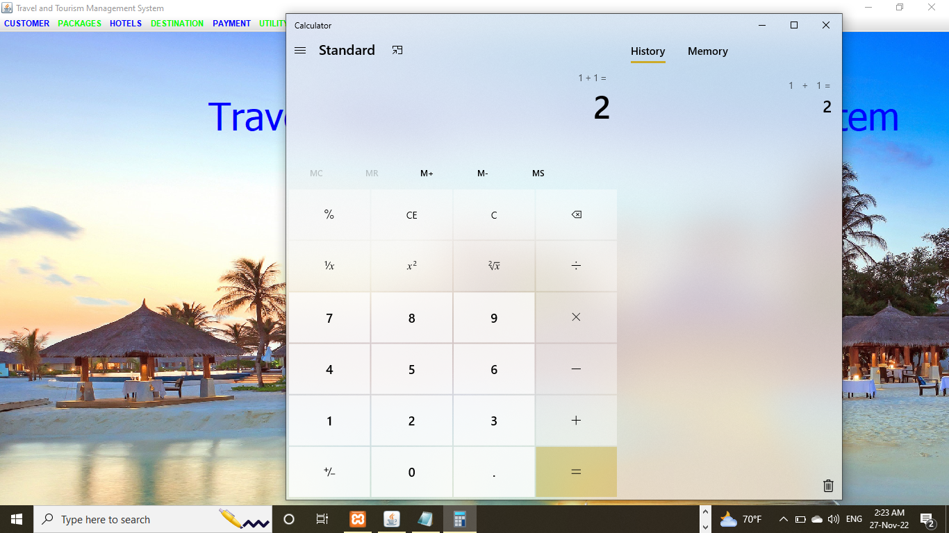
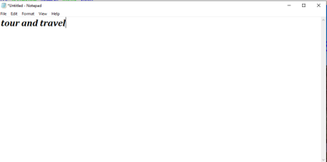
Front-End UI & Proper Styling
Destination
Payment
About
Utility

Slide 13
Back-End & Database
Travel&touystemrmanagement
Account
Bookhotel
Bookpackage
Customer
Hotel
Package
account
Username
Name
Password
Question
answer
Bookpackage
Username
package
Id
Number
Phone
Price
Bookhotel
Username
Name
Persons
Days
Ac
Food
Id
Number
Phone
Price
customer
Username
id
Number
Name
Gender
Country
Address
Phone
Email
Hotel
Name
Costperperson
Acroom
Foodincluded

Slide 14
Software Documentation
About readme file of this project: The Readme file is often the first file that the users read.
Our project is user friendly. In our project -----------
1) This project helps a customer to choose a tourist place and book hotels for tour and travel.
2) The project is useful because customers can easily use this software for their travelling the beautiful places .
3) first user have to sign up then they could login in this software easily. If they forget their password they could easily create a new password by forget password option . After login they could to see software dashboard and use this by follow their choice . In this software user could book package and hotel and observed a nice tour. User /Customer could see a lot of historical and beautiful place. They also calculate their cost in this software in calculator section.
4)In About section user can get help in project.
5)Admins/developers maintains and contributes to the project.
In this project they have to work about add customer, delete customer ,update customer and view customer.
They could provide different package to follow their customer choice. They also could change destination place. Admin could note a list of their daily update of this software in the notepad.

Slide 15
Limitation
1) we don't add payment method because we don't have gateway access.
2) Then this is not compressed software. if there lot of user enter the software the server will be down

Slide 16

Future Scope of the Project
User-friendly booking options
Easy Payment options
Being in touch with the traveler during the entire journey

Slide 17
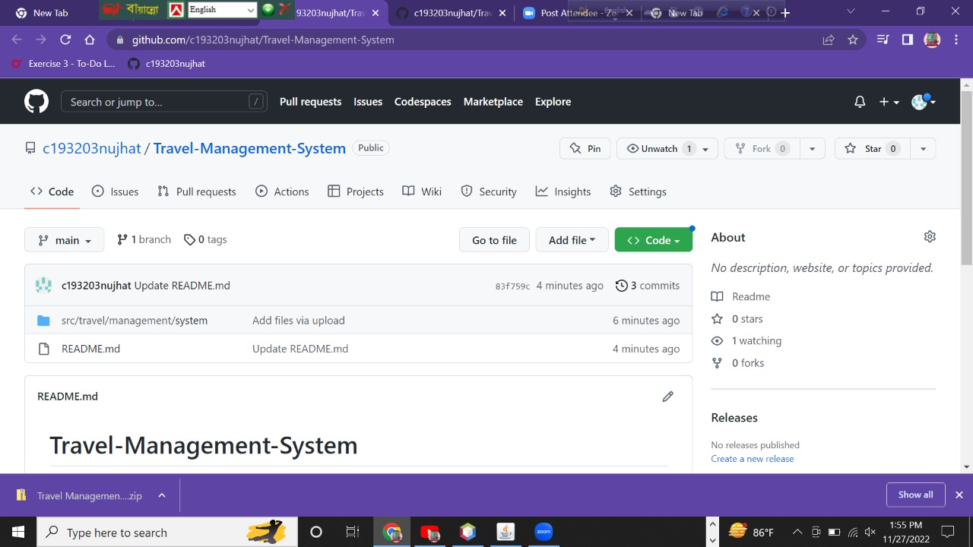
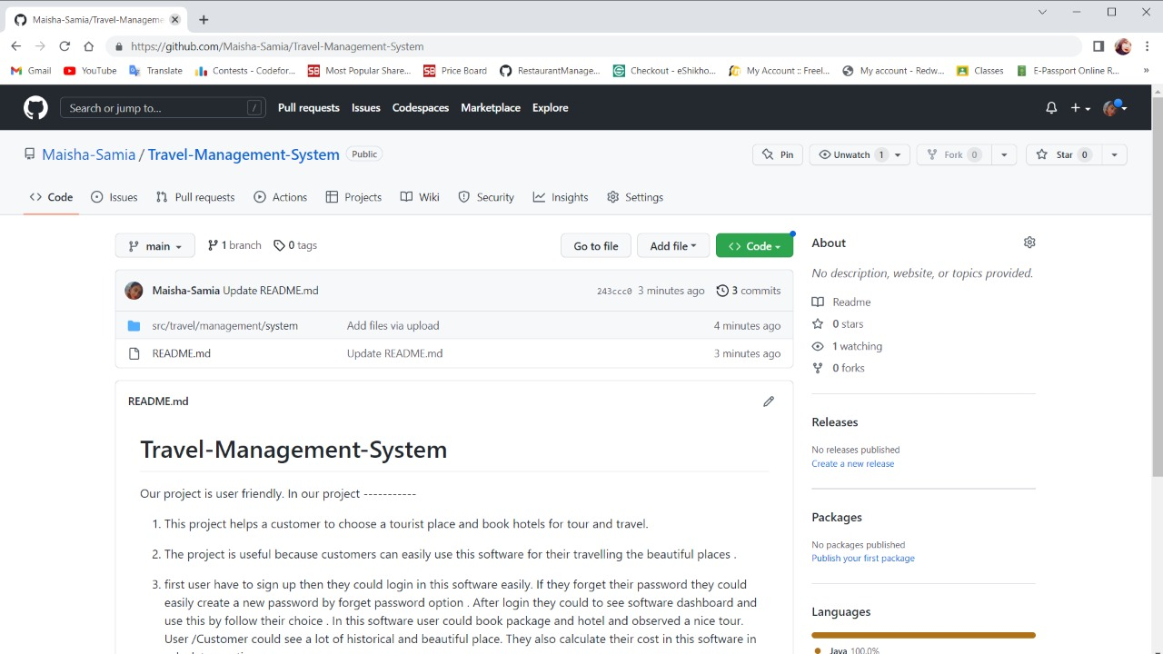
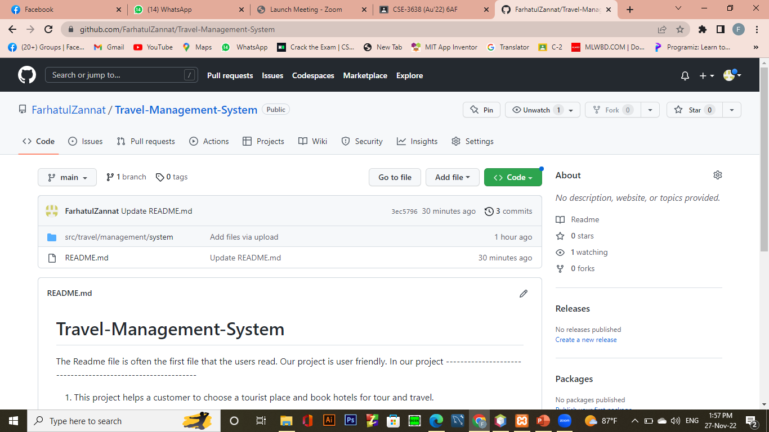

Github link ---------------------------
C193203 : https://github.com/c193203nujhat/Travel-Management-System
C193213 : https://github.com/Maisha-Samia/Travel-Management-System
C193219 : https://github.com/FarhatulZannat/Travel-Management-System
C193257 : https://github.com/SharminAkter57/Travel-Management-System

Slide 18

ASSALAMUALIKUM

